Slide 1

Smart Local Guide
G9 - The Eagles
A Recommender System Leveraging
Google Reviews and Metadata
Team members:
Rushikesh Gholap (rg954@drexel.edu)
Hassaan Alvi (haa76@drexel.edu)
Jelitta James (jj982@drexel.edu)
Priyanka Choudhary (pc845@drexel.edu)
Krish Balar (kb3842@drexel.edu)

Slide 2
Team – Group 9: The Eagles
Roles & Responsibilities:
Rushikesh Gholap: Data discovery, Data Flow, Architecture & EDA
Jelitta James: Data cleaning, Pre-processing and EDA
Hassaan Alvi: Data cleaning, EDA, Pre-Processing
Priyanka Choudhary: Pre-Processing, EDA, Feature Engineering
Krish Balar: Data cleaning & Pre-Processing, EDA, Feature Engineering
Collaboration:
Regular Zoom meetings, daily messaging, and shared tools (Google Drive, GitHub).

Slide 3
Project Overview
Objective
Develop a recommender system leveraging Google Reviews and metadata
Dataset Source
Google Local Reviews dataset from UCSD’s McAuley Group
Primary Goal
Provide personalized and relevant business recommendations

Slide 4
Key Components of the Project
Data Discovery & Acquisition
Data Cleaning & Pre-Processing
Exploratory Data Analysis
Sentiment Analysis
Feature Engineering

Slide 5
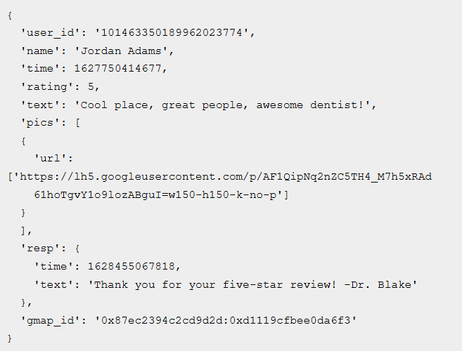
Data Source - Google Local Reviews dataset from UCSD’s McAuley Group
User Review Sample to a Business Location:
user_id - ID of the reviewer
name - name of the reviewer
time - time of the review (unix time)
rating - rating of the business
text - text of the review
pics - pictures of the review
resp - business response to the review including unix time and text of the response
gmap_id - ID of the business

Slide 6
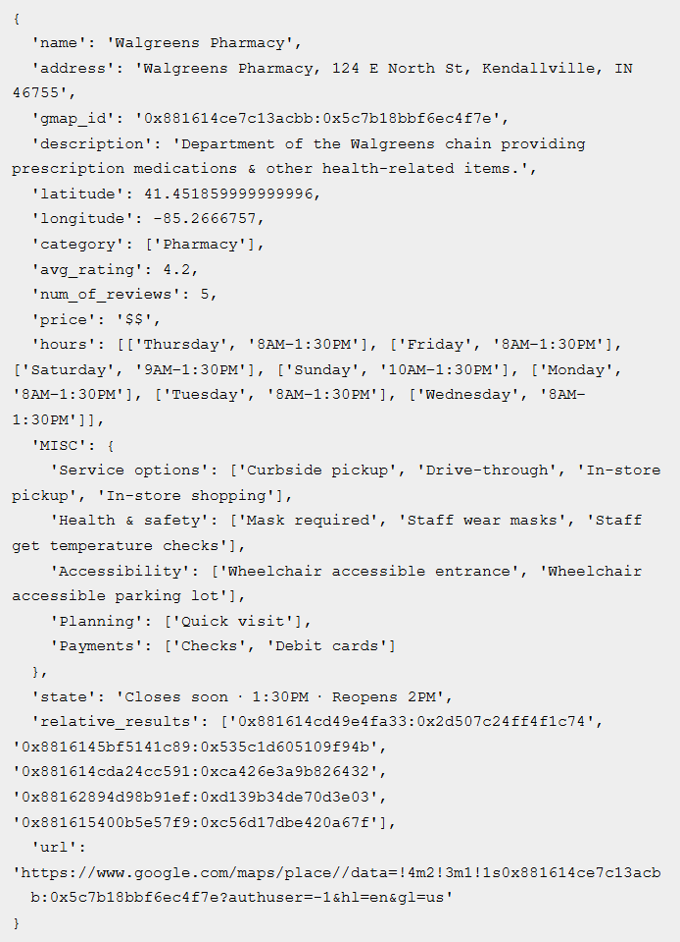
Data Source - Google Local Reviews dataset from UCSD’s McAuley Group
User Business Metadata Data Sample:
User Business Metadata Data Sample:
name - name of the business
address - address of the business
gmap_id - ID of the business
description - description of the business
latitude - latitude of the business
longitude - longitude of the business
category - category of the business
avg_rating - average rating of the business
num_of_reviews - number of reviews
price - price of the business
hours - open hours
MISC - MISC information
state - the current status of the business (e.g., permanently closed)
relative_results - relative businesses recommended by Google
url - URL of the business

Slide 7
How do we manage Large Dataset
Load Only Essential Data into Memory
Optimized Querying Techniques
Incremental and Batch Processing
Commit Processed Data Promptly
Memory Management and Algorithm Optimization
Parallel Processing and Resource Management

Slide 8
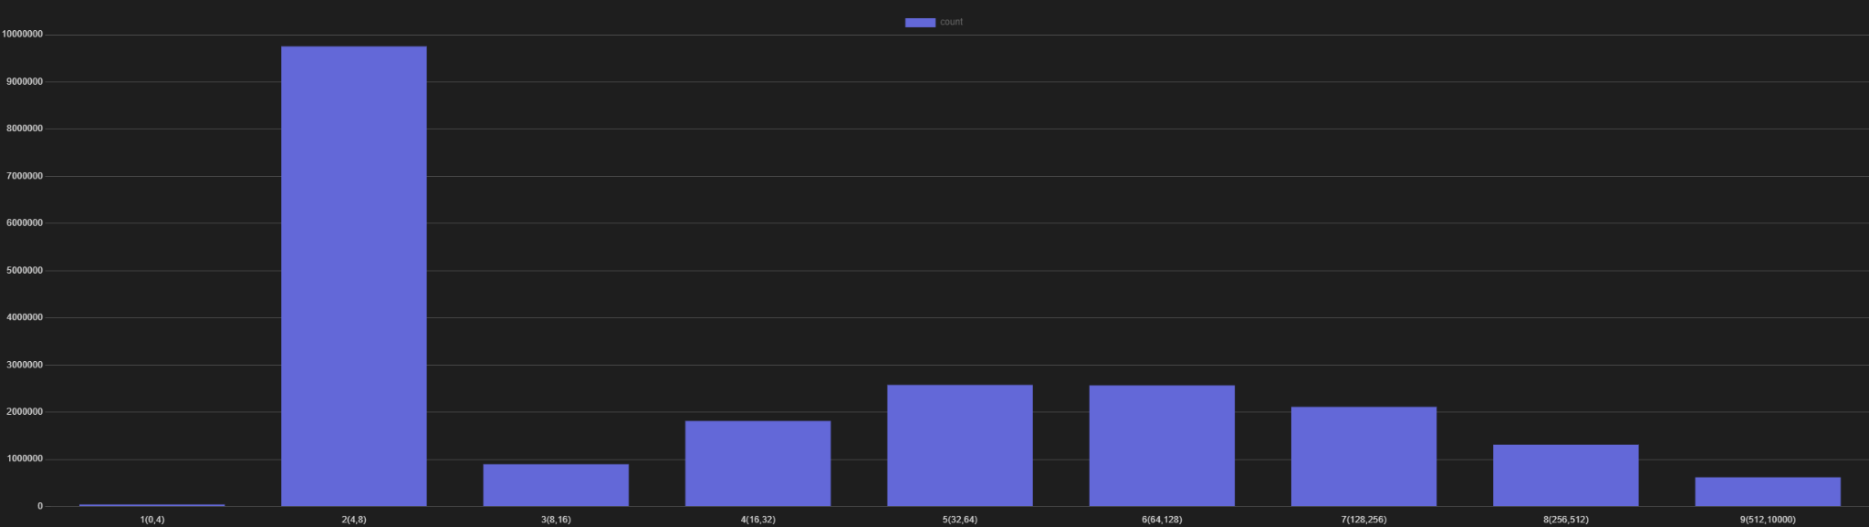
Eg of Processing sentiment analysis on humongous Data.
Normal execution time on entire PA’s text sentiment extraction : 35 Hours
After Batchwise optimization and intelligent data extractions : 3.5 Hours

Slide 9
Setup and Tools
Postgres
Hugging Face Pipelines for Sentiment Analysis
Pyspark for performing complex calculations
Django for prototyping UI
DDNS Setup

Slide 10
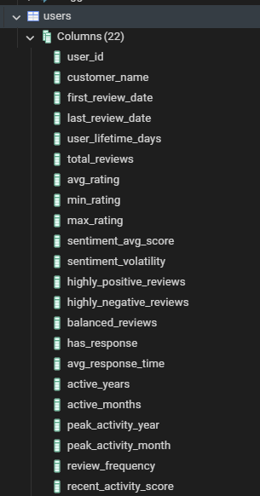
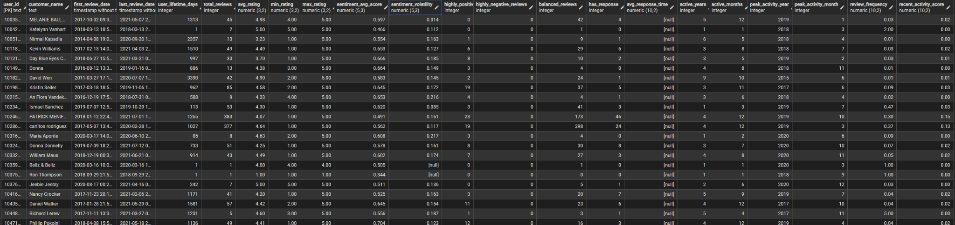
Feature engineered Table On Users

Slide 11
Data Pre-processing
Handling Duplicates:
254,227 duplicate reviews removed
980 duplicate business records removed
Handling Missing Data:
Dropped highly sparse columns (Pics, Response, Description, Price)
Imputed missing ratings using business metadata
Used geolocation as a proxy for missing addresses
Transformation & Standardization:
Converted UNIX timestamps to human-readable format
Normalized text data for NLP

Slide 12
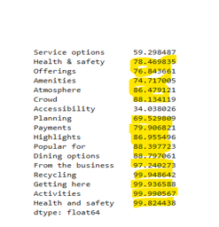
Data Pre-processing
Handling complex data
MISC is a complex with many categorical features
More than 80% data is missing
Dropped all columns except for Service options.

Slide 13
Exploratory Data Analysis
Objective: Understand dataset structure and key insights
Analysis Areas:
Data distribution and patterns
Missing values and outliers
User behavior and rating trends

Slide 14
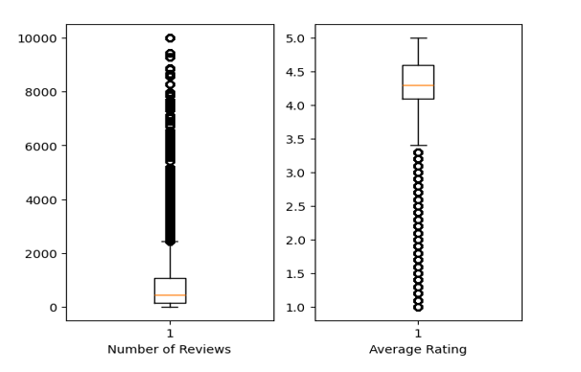
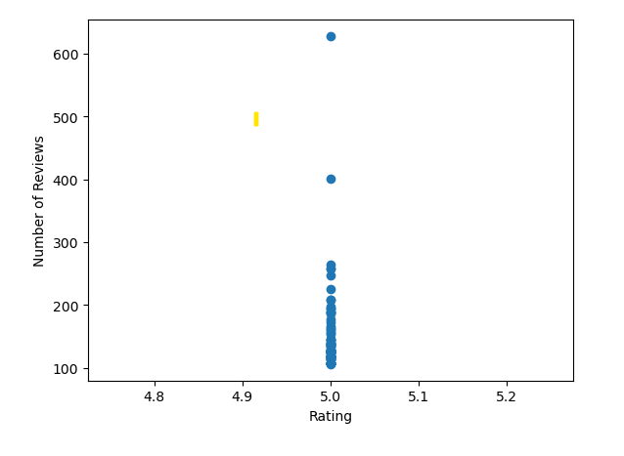
Business Ratings & Review Count
Key Findings:
Most businesses have high ratings (4.0 - 5.0)
Businesses with low ratings usually have fewer reviews
Business with only one rating of 5.0
Impacts:
Bias toward recommending popular, highly rated businesses.
Filter out low-rated and inactive businesses
Actionable steps:
Group businesses into clusters based on similar attributes, ensuring that users can discover businesses within certain categories or niches

Slide 15
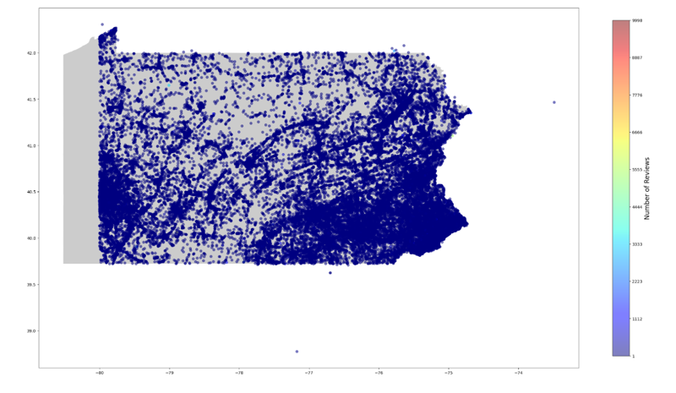
Business Geospatial Analysis
Key Findings:
The geospatial analysis flagged certain latitude and longitude points as outliers relative to the boundaries of PA.
Impacts:
These coordinates being outside the PA boundaries could lead to poor or irrelevant recommendations for users located within PA.
Users might be recommended locations or services that aren't within their region, thereby degrading user experience and reducing system reliability.
Actionable steps:
Correct the data to drop incorrect business.

Slide 16
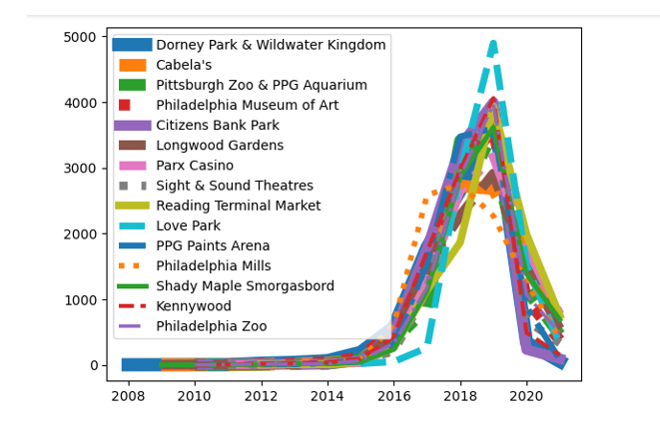
Business Growth Trends
Key Findings:
Exponential growth in reviews (2017-2019)
Slowdown post-2020 (potential saturation or external factors)
Impacts:
System might overemphasize recent preferences at the expense of older, more established preferences
Actionable steps:
Weight recent data more heavily
Use seasonal trends for recommendation optimization

Slide 17
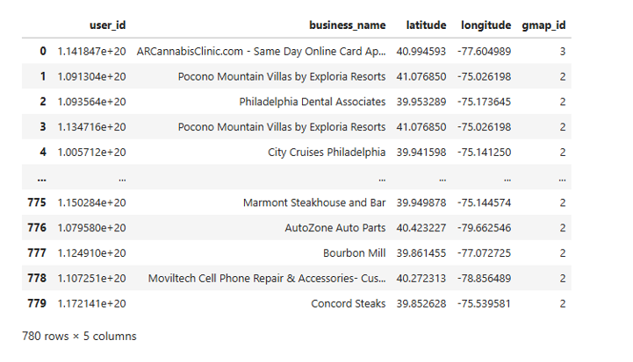
User Review Behavior
Key Findings:
Users reviewed same business multiple times
Impacts:
Repeated reviews from the same user could create data redundancy, causing the recommender system to overemphasize that user's opinion of the business.
Implement engagement strategies for long-term retention
Actionable steps:
Averaging multiple reviews to avoid over-representation

Slide 18
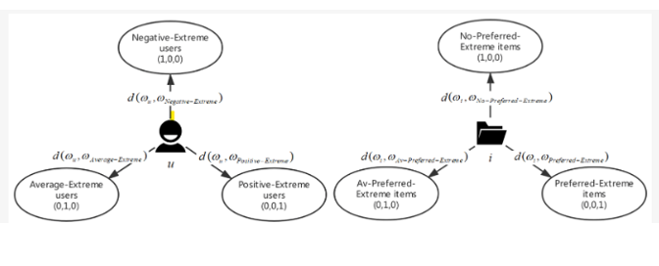
User Review Noise Detection
Key Findings:
Identified ~1.8M noisy reviews using distance-based rating calculations
Implications:
significantly degrade the performance of a recommender system
Actionable Steps:
Remove or weight noisy reviews to reduce their influence on recommendations

Slide 19
Exploratory Data Analysis II
Objective: Analysis of Reviews data
Analysis Areas:
Reviews frequency and distribution
User Sentiments vs. Ratings
Rating trends over time

Slide 20
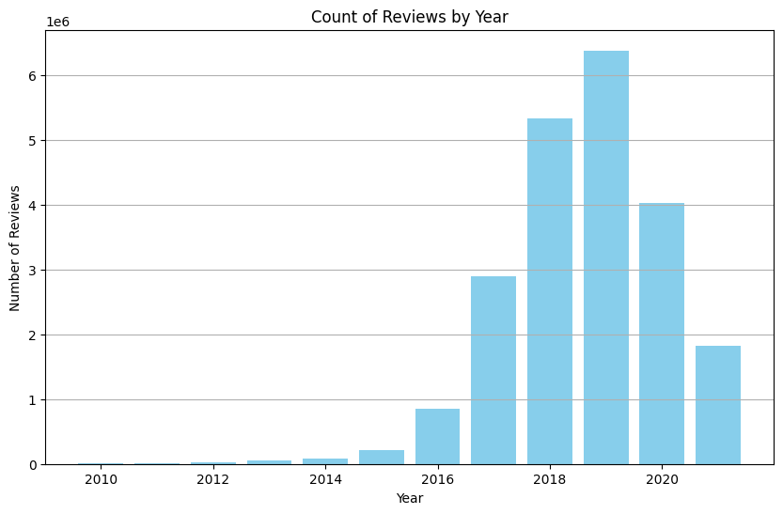
Yearly Review Frequency

Slide 21
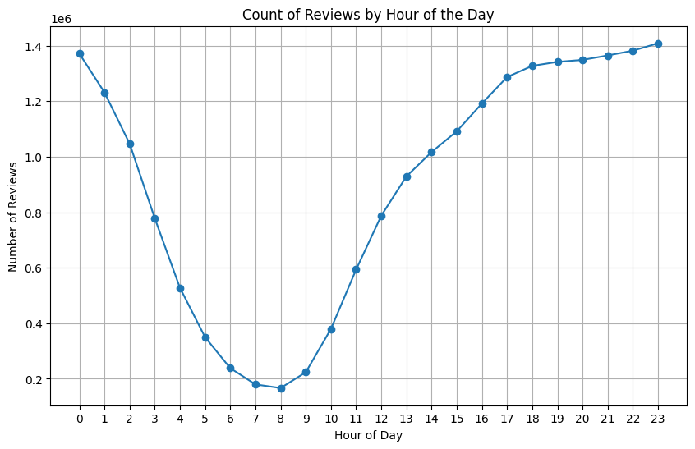
Review Pattern Hourly

Slide 22
Review Frequency Trends
Review volume peaks in the evening (6 PM - 12 AM)
Highest engagement period: 2017-2019, slight decline post-2020
Application in Recommender System:
Prioritize real-time updates in the evening
Focus on recent reviews for recommendations

Slide 23
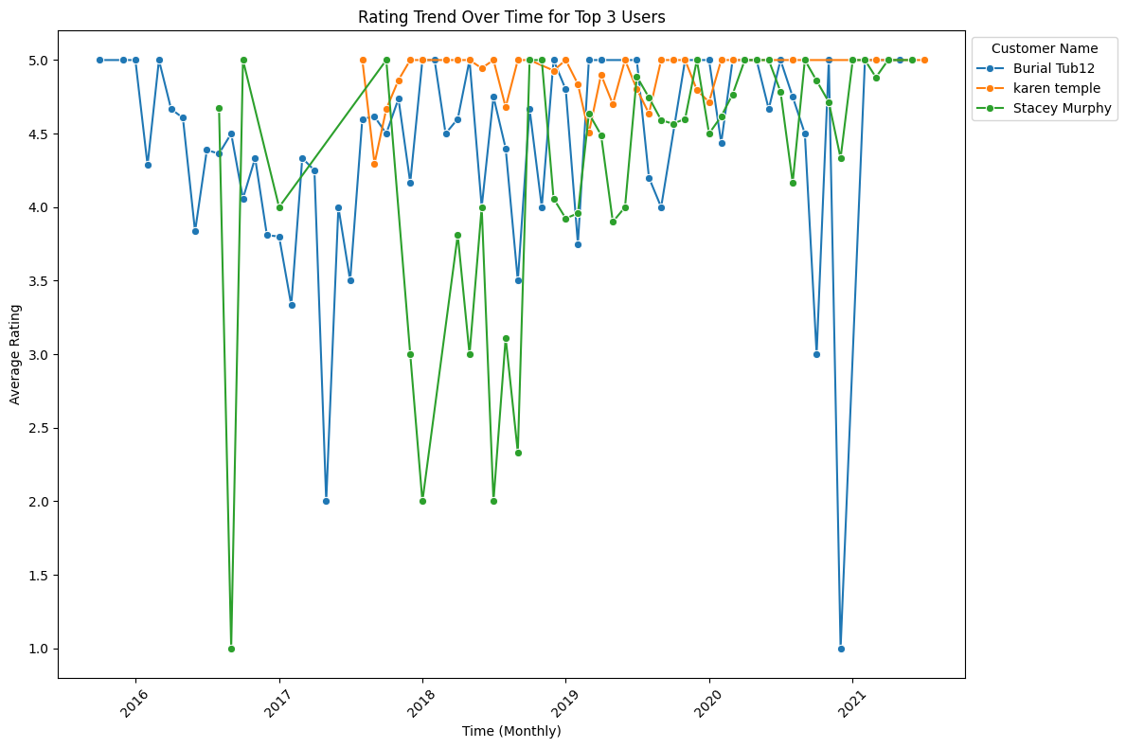
Rating Trend for Top Users

Slide 24
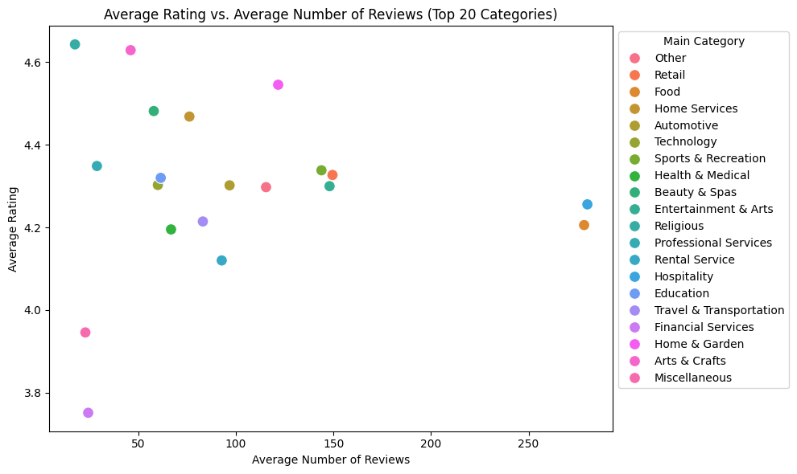
Average Rating vs. Average Number of Reviews

Slide 25
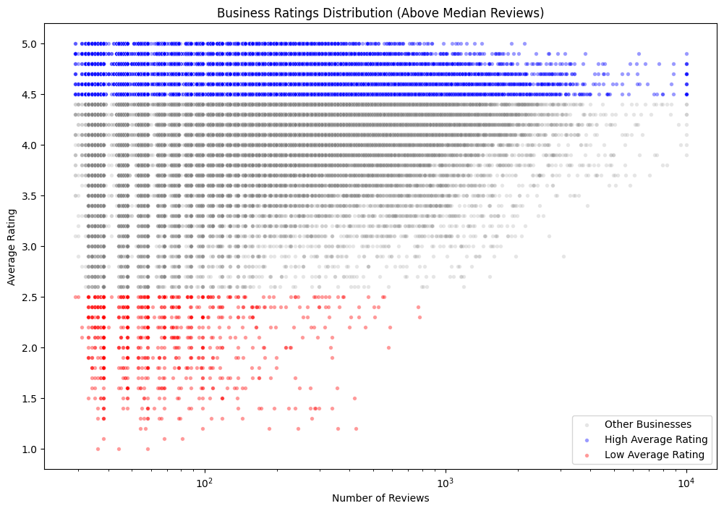
Rating Distribution for Businesses

Slide 26
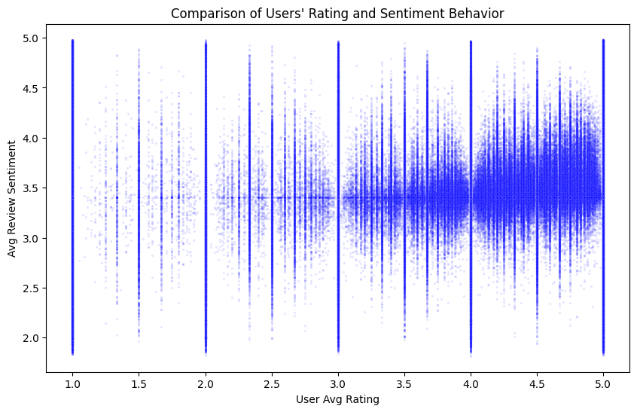
Rating vs. Sentiment Behaviour

Slide 27
Sentiment Analysis in Reviews
Findings:
Vertical bands suggest that users with the same average rating still express a wide range of sentiments.
Some users give low ratings but still express positive sentiments
Certain businesses receive consistent negative feedback despite moderate ratings
No strong correlation between rating and sentiment score
Implementation in Recommender System:
Integrate sentiment analysis for more accurate recommendations

Slide 28
Feature Engineering for Predictive Modeling
Structured Transformation:
Extracted unique business categories from unstructured text
Applied One-Hot Encoding for categorical variables
Dimensionality Reduction:
Used Truncated SVD to reduce high-dimensional features
Refining User Profiles:
Grouped users based on review frequency and engagement levels

Slide 29
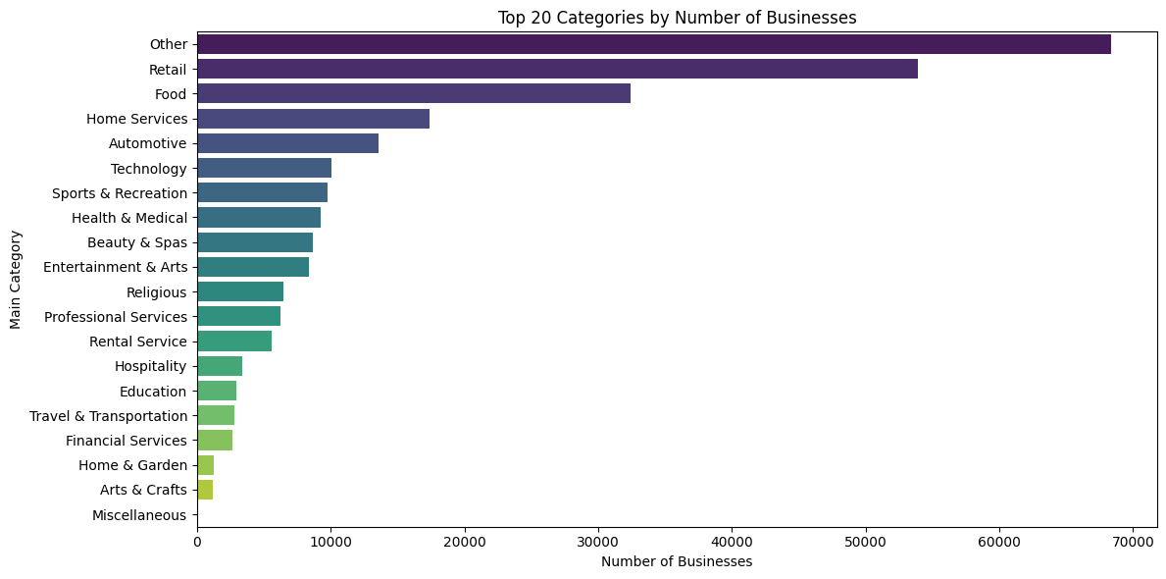
Top Categories by Number of Businesses

Slide 30
Top Business Categories Analysis
Most reviewed categories: Hospitality, Food, Retail
Least reviewed categories: Financial Services, Arts & Crafts
Rating Trends:
Highly rated: Arts & Crafts, Home & Garden
Poorly rated: Miscellaneous category
Impact on Recommender System:
Prioritize popular and highly rated business categories

Slide 31
Challenges and Limitations
Large Dataset
Considering only the Pennsylvania data.
Computation Power Limitations
Uploaded the dataset in SQL Database, and pulling out only the required data at a time, to do analysis and pre-processing
Complex Data Structure
Using feature engineering, we have generated few necessary columns, from the complex structure of data

Slide 32
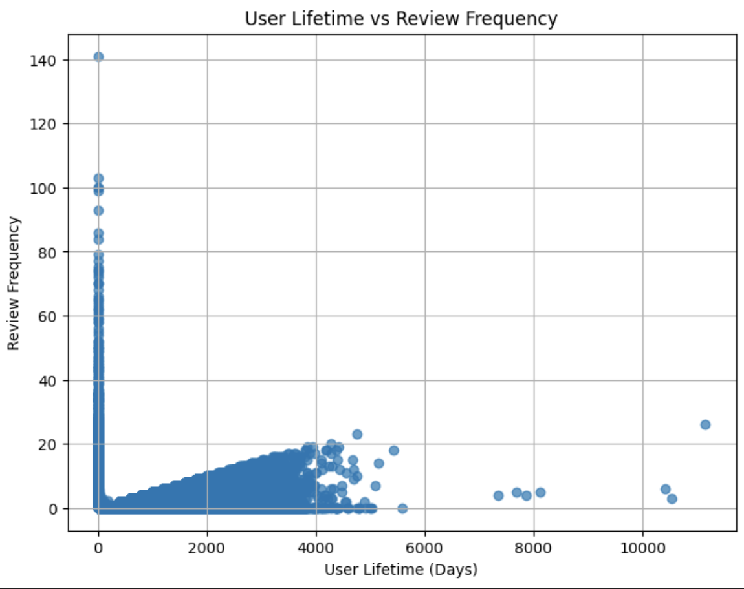
Key Changes
Outliers: Eliminated the fake and dormant users, detected using EDA

Slide 33
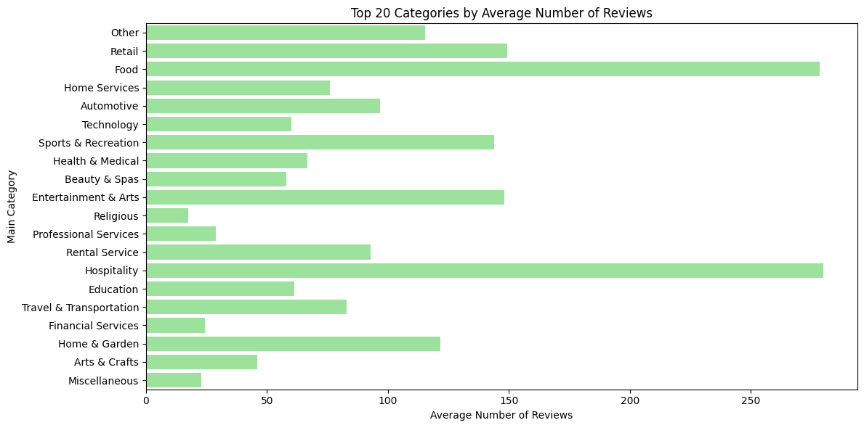
Key Changes
Limited Business Category: We are now considering only one category i.e. Food, for our future model building and development.

Slide 34
Next Steps
The algorithms which we are going to use to generate recommendation in our next capstone part are LensKit toolkit algorithms
We are also considering our proposed algorithms, i.e. NCF and RNN, but it’s our second choice.
The dataset which we are going to use to train our models is the filtered and pre-processed data from our analysis.

Slide 35
Conclusion
Removed duplicates, handled missing values, dropped irrelevant columns.
Transformed unstructured text (e.g., categories) into usable features via One-Hot Encoding and dimensionality reduction (Truncated SVD).
Applied noise detection techniques and logical filters to eliminate unreliable users and businesses.
Identified patterns in user behavior, business ratings, and review trends to guide feature selection and model design.
Finally, the dataset is ready for training.

Slide 36
Thank You

